Slide 1
Detection Of Depression From Textual Data In Social Media Using Machine Learning
Presented By : Malavika P

Slide 2
Table of contents
01.
04.
02.
05.
03.
06.
Abstract
Summary Table
Introduction
Project Proposal
Literature Review
Methodology
07.
08.
Conclusion
Dataset

Slide 3
Abstract
Depression is one of the leading causes of suicide worldwide. However, a large percentage of cases of depression go undiagnosed and, thus, untreated. Previous studies have found that messages posted by individuals with major depressive disorder on social media platforms can be analysed to predict if they are suffering, or likely to suffer, from depression. This study aims to detect depression from textual data posted on social media using machine learning classifiers and advanced feature extraction methods.

Slide 4
Introduction
Depression is a leading cause of suicide, affecting over 300 million people worldwide (WHO). Often Many depression cases go undiagnosed and untreated.
Studies show that social media posts, especially tweets, can predict episodes of depression.
Increasingly, teenagers and young adults express feelings of depression on social media because of the social stigma.
Related work on this domain rely on specific keywords (e.g., 'depression'), which many users avoid due to stigma.
The goal of this project is to develop a machine learning model to detect depression from social media text without relying on explicit keywords, focusing on patterns and signals for early detection and intervention.

Slide 5
Literature Review - Paper 1
Title: Detection of Depression-Related Posts in Reddit Social Media Forum Authors: Tadesse MM, Lin H, Xu B, Yang L.
Data Set: The dataset was built by Inna Pirina et al. and consists of a list of depressed and non-depressed users.
Feature Extraction:
N-grams (word pairs and triplets).
Linguistic Inquiry and Word Count (LIWC) for psychological analysis.
Latent Dirichlet Allocation (LDA) for topic modeling..
Classifiers:
LR, SVM, RF, AdaBoost, MLP.
Result: Achieved the best accuracy of 91% using a combination of LIWC, LDA, and bigram features with the MLP classifier.

Slide 6
Literature Review - Paper 2
Title: A textual-based featuring approach for depression detection using machine learning classifiers and social media texts Authors: Chiong R, Budhi GS, Dhakal S, Chiong F.
Data Set:
. Shen et al.
Eye BB (2020): Focuses on depression analysis.
Tanwar R (2020): Based on the diary of a 17-year-old girl, Victoria, who committed suicide due to depression.
Komati N (2020): Includes posts from Reddit communities r/SuicideWatch and r/depression.
Virahonda S (2020): Consists of comments related to depression and anxiety.
Feature Extraction: Bag-of-words and n-grams for textual analysis.
Classifiers:
Single classifiers: LR, SVM, MLP, DT
Ensemble classifiers: RF, AdaBoost, Bagging, Gradient Boosting
Result: Best single classifier: LR (92.61% accuracy on Eye's dataset) Best ensemble: RF (balanced accuracy for depression/non-depression classes)

Slide 7
Literature Review - Paper 3
Title: Depression detection from social network data using machine learning techniques Authors: Islam MR, Kabir MA, Ahmed A, Kamal AR, Wang H, Ulhaq A.
Data Set: Publicly available Facebook data (from bipolar, depression, and anxiety Facebook pages)
Feature Extraction: LIWC for capturing psychological attributes.
Classifiers: Decision Tree, K-NN, Support Vector Machine, Ensemble Methods
Result: Accuracy ranged between 60-80% with the Decision Tree classifier performing best

Slide 8
Summary Table
Title | Year | Journal Name/Publisher | Summary
Detection of Depression-Related Posts in Reddit Social Media Forum | 2019 | Ieee Access | LIWC,LDA,N-gram for feature extraction MLP-91%
A textual-based featuring approach for depression detection using machine learning classifiers and social media texts | 2021 | Computers in Biology and Medicine | BOW,Ngram for feature extraction Best single classifier: LR(92.61%) Best ensemble classifier: RF
Depression detection from social network data using machine learning techniques | 2018 | Health Information Science and Systems | LIWC to extract psychological features such as emotional,temporal, linguistic styles DT with 60-80% accuracy is the best classifier .

Slide 9
Project Proposal
From these 3 papers I propose developing a robust machine learning model to detect depression from social media text data irrespective of the presence of depressive or non depressive keywords. The model tends to detect and extract the emotion using LIWC from the text. The model will combine Multilayer Perceptron (MLP), Random Forest (RF), and Decision Tree (DT) algorithms to classify features extracted using N-gram, and TF-IDF vectorisation
N-gram: sequence of N words in a text, unigram, bigram, Look for common phrases.
TF_IDF: statistical measure used to evaluate the importance of a word in a document relative to a collection of documents, highlighting terms that are more relevant to a specific document.
The output will identify depressive content and provide potential recommendations or support options. Additionally, I will design a user-friendly web application using the Flask framework for real-time analysis and feedback.

Slide 10
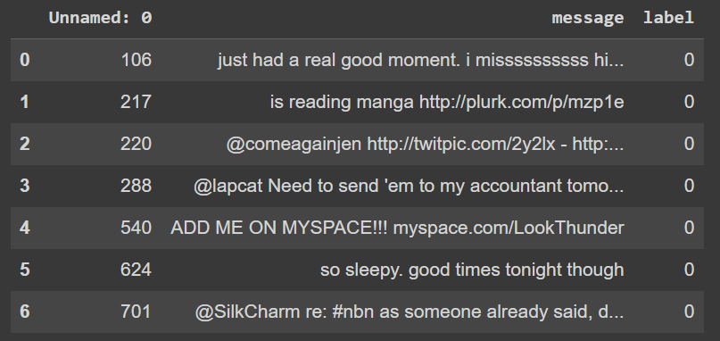
Dataset
The datasets used in this project are the dataset that is mentioned paper 2.
The following is the dataset mentioned:
• Eye BB (2020): This dataset focuses on depression analysis. Contains 10314 rows. 3 columns including text, id and label which is a class identifier.

Slide 11

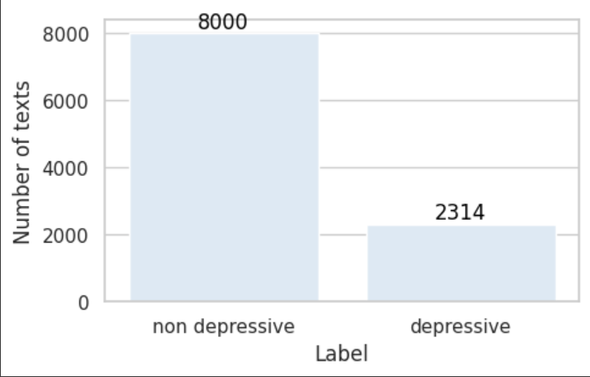
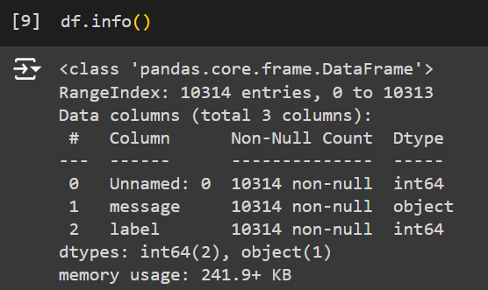
Exploratory Analysis
Dataset has 10314 rows and 3 columns.
Dataset contains 1 non-numerical and 2 numerical attributes out of which unnamed attribute is irrelevant 0 indicates non-depressive and 1 indicates depressive.
Dataset contains 8000 non-depressive texts and 2314 depressive texts.

Slide 12
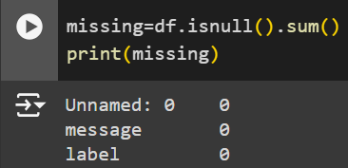
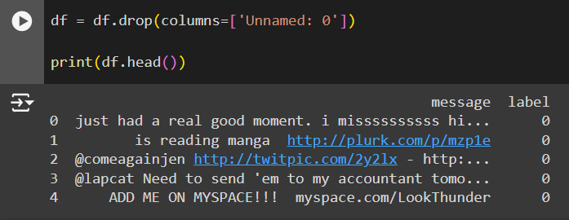
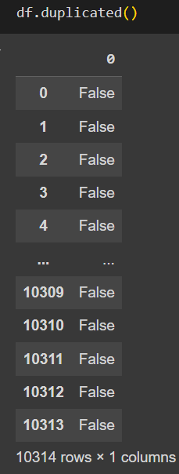
Data Preprocessing
Dropped Irrelevant Features
Dropped Irrelevant feature column Unnamed: 0.
Missing Values
There are no missing values in the dataset.
Duplicate Values
There are no duplicate values in the dataset.

Slide 13
Text Preprocessing
The goal is to clean and standardize the dataset for better analysis and modeling. Key preprocessing steps include:
Removing Extra Spaces, Mentions, and Hyperlinks: Regular expressions eliminate unnecessary spaces, mentions (e.g., '@user'), and hyperlinks.
Removing Punctuation, Numbers, and Capitalization: Punctuation and numbers are removed, and text is converted to lowercase to ensure consistency.
Tokenization: The cleaned messages are split into individual words.
Stemming: Words are reduced to their root forms using the Porter stemming algorithm.
Stopword Removal: Common stopwords and Twitter-specific terms are filtered out.
Dataset Update: The processed messages are added as a new column in the dataset for further analysis.
NLTK handles stopwords and stemming, while the ‘re’ library manages string manipulation

Slide 14
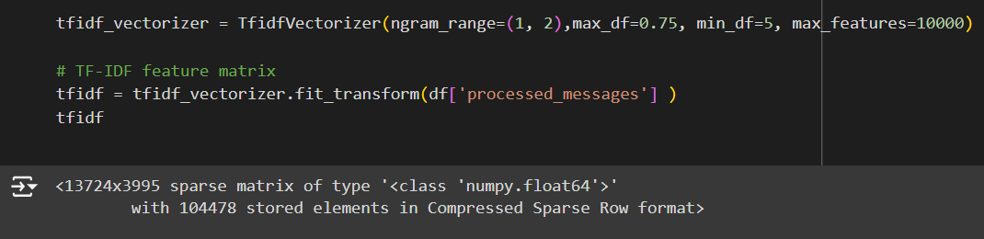
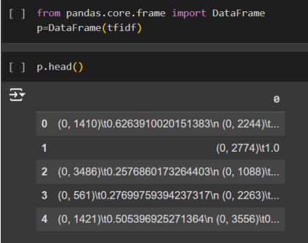
Working of Feature Extraction:
1. TfidfVectorizer Configuration
ngram_range = (1, 2):
Considers unigrams (single words) and bigrams (two-word combinations).
max_df = 0.75:
Ignores terms appearing in over 75% of documents (too common).
min_df = 5:
Excludes terms appearing in fewer than 5 documents (too rare).
max_features = 10,000:
Limits the vocabulary to the top 10,000 terms (controls dimensionality).
2. TF-IDF Feature Matrix
fit_transform() generates a sparse matrix.
Rows: Represent individual documents/messages.
Columns: Represent the TF-IDF scores for words/phrases.
3. Conversion to DataFrame
Sparse matrix is converted to a Pandas DataFrame.
Structured and user-friendly for easier analysis and inspection.
4. Preview of TF-IDF DataFrame
head() displays the first few rows.
Provides insight into the numerical representation of the text data.

Slide 15
Working Of Algorithms
Random Forest:
Step-1: Select random K data points from the training set.
Step-2: Build the decision trees associated with the selected data points (Subsets).
Step-3: Choose the number N for decision trees that you want to build.
Step-4: Repeat Step 1 & 2.
Step-5: For new data points, find the predictions of each decision tree, and assign the new data points to the category that wins the majority votes.

Slide 16
Decision Tree
Step 1: Start with the entire dataset at the root node.
Step 2: Select the best feature to split the data at the root node.
Step 3: Split the dataset into subsets based on the chosen feature and split point.
Step 4: Repeat Steps 2 & 3 for each subset to build the tree.
Step 5: Assign a final prediction to each leaf node.
Step 6: For new data points, pass them down the tree to reach a leaf node and output the prediction.

Slide 17
Multilayer Perceptron
Step 1:
Input Layer
• The input features are fed into the input layer, with each feature represented by a neuron.
Step 2: Forward Propagation
• Hidden Layers: Each neuron computes a weighted sum of its inputs, applies an activation function, and passes the result to the next layer.
• This process repeats through all hidden layers.
Step 3:
Output Layer
• The final layer computes the output, applying an activation function if needed (e.g., Softmax for classification).
Step 4:
Loss Calculation
• The difference between the predicted and actual output is calculated using a loss function.
Step 5: Backpropagation
• The error is backpropagated to update the weights using gradient descent.
Step 6:
Training
• Repeat forward propagation, loss calculation, and backpropagation for several iterations to minimize the loss.
Step 7:
Prediction
• After training, the MLP makes predictions on new data using forward propagation.

Slide 18
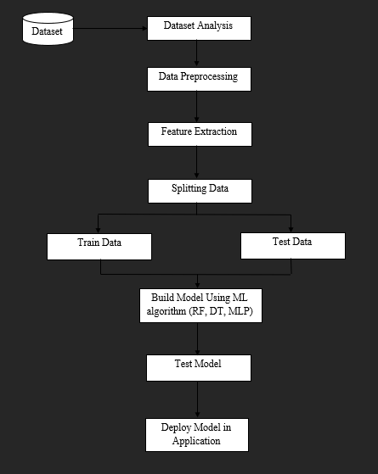
Project Pipeline

Slide 19
Timeline
Sprint release 1:
Resampling and Feature Extraction
Sprint release 2:
Model building using RF , DT and MLP
Sprint release 3:
Interface design and Deployment

Slide 20
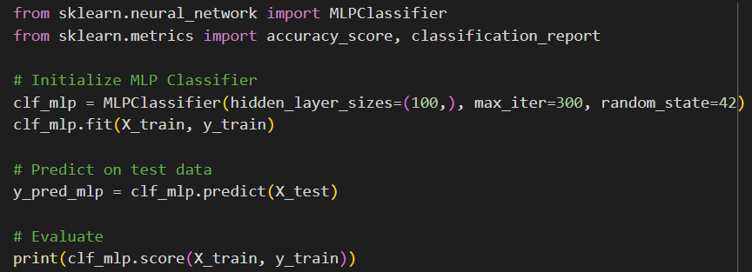

Model Training
The dataset was divided into two parts. X representing the input features, and y representing the target variable. The training set consists of 80% of the data and is used to train the model.
MLP Model:
The model achieved an accuracy of 99.10% on the training data.
The model consists of 100 neurons in the hidden layer. The maximum number of iterations is set to 300 for training, and the random_state is set to 42 to ensure reproducibility. The classifier is fit to the training data (X_train, y_train), and predictions are made on the test data (X_test).

Slide 21
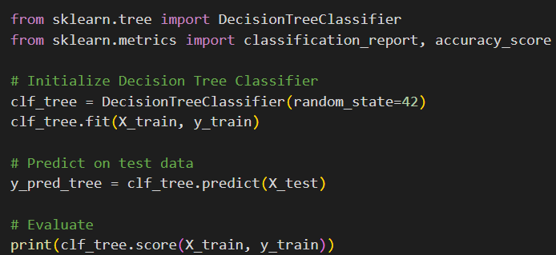
Decision Tree
The model achieved an accuracy of 99.49% on the training data.
The model is initialized with a set random_state of 42, which ensures that the results are reproducible by controlling the randomness in the training process. The classifier is fit to the training data (X_train, y_train), and predictions are made on the test data (X_test).

Slide 22
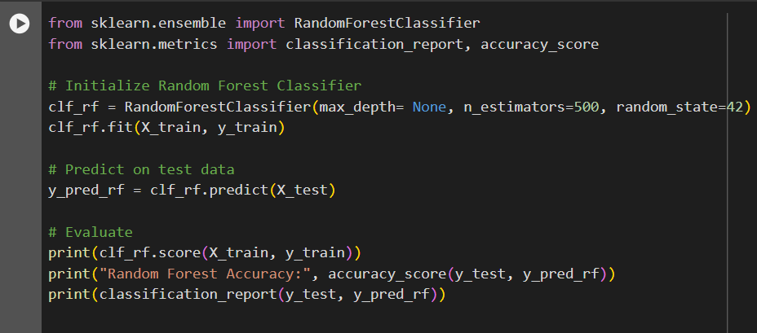

Random Forest
A Random Forest Classifier, which is an ensemble learning method based on multiple decision trees is used to train the model. The model consists of 500 decision trees. The maximum depth of each tree is none and random_state is set to 42 to ensure reproducibility. The classifier is fit to the training data (X_train, y_train), and predictions are made on the test data (X_test).
The model achieved an accuracy of 99.49% on the training data.

Slide 23
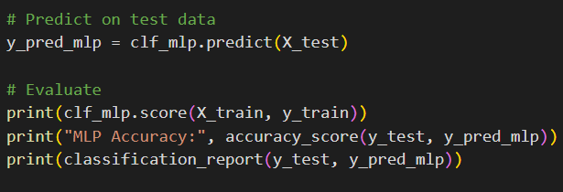
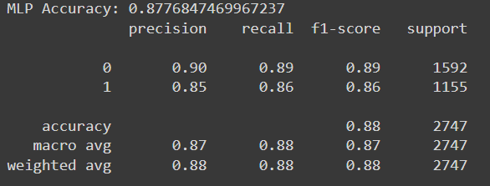
Model Testing
MLP Model:
MLP acquired a test accuracy of 87.76%.

Slide 24
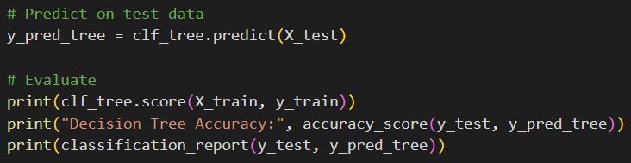
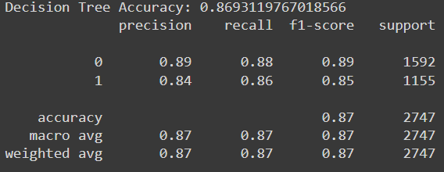
Decision Tree
Decision Tree acquired a test accuracy of 86.93%

Slide 25
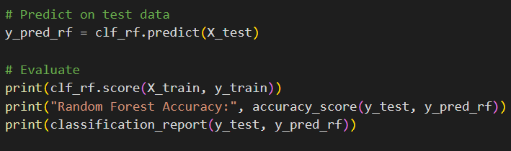
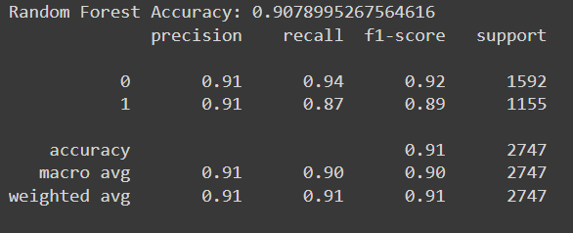
Random Forest
Random Forest acquired a test accuracy of 90.78%.
By Comparison of accuracy, we got to know that Random Forest is the good performing model of highest train and test accuracy.

Slide 26
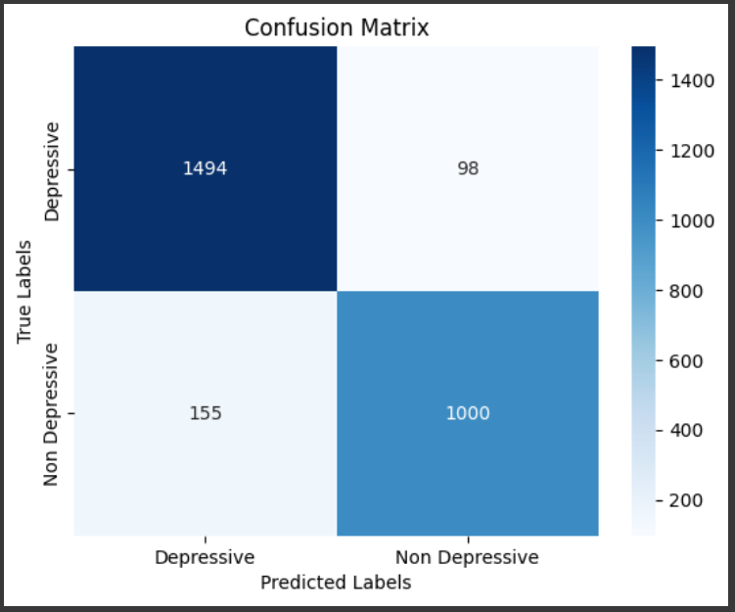
Confusion Matrix of Random Forest

Slide 27
Conclusion
In conclusion, This project aims to detect depression from social media texts using machine learning techniques.
As depression is a widespread global issue, my primary objective is to develop a machine learning model that can identify depressive indicators in online platforms where people often express their thoughts and emotions.
I believe this project has significant potential and I am looking forward to implement it.

Slide 28
THANK YOU

